Slide 1
UNIT-4. Transducers
Dr. M. Arun Noyal Doss
Associate Professor
SRMIST,

Slide 2
Introduction
Basically transducer is defined as a device, which converts energy or information from one form to another.
These are widely used in measurement work because not all quantities that need to be measured can be displayed as easily as others.
A better measurement of a quantity can usually be made if it may be converted to another form, which is more conveniently or accurately displayed.

Slide 3
Introduction(cont’d)
For example, the common mercury thermometer converts variations in temperature into variations in the length of a column of mercury.
Since the variation in the length of the mercury column is rather simple to measure, the mercury thermometer becomes a convenient device for measuring temperature.

Slide 4
Introduction(cont’d)
On the other hand, the actual temperature variation is not as easy to display directly.
Another example is manometer, which detects pressure and indicates it directly on a scale calibrated in actual units of pressure.

Slide 5
Introduction(cont’d)
Thus the transducer is a device, which provides a usable output in response to specific input measured, which may be physical or mechanical quantity, property or condition.
The transducer may be mechanical, electrical, magnetic, optical, chemical, acoustic, thermal nuclear, or a combination of any two or more of these.

Slide 6
Mechanical transducers
are simple and rugged in construction, cheaper in cost, accurate and operate without external power supplies but are not advantageous for many of the modern scientific experiments and process control instrumentation owing to their poor frequency response, requirement of large forces to overcome mechanical friction, in compatibility when remote control or indication is required, and a lot of other limitations. All these drawbacks have been overcome with the introduction of electrical transducers.

Slide 7
ELECTRICAL TRANSDUCERS
Mostly quantities to be measured are non-electrical such as temperature, pressure, displacement, humidity, fluid flow, speed etc., but these quantities cannot be measured directly. Hence such quantities are required to be sensed and changed into some other form for easy measurement.
Electrical quantities such as current, voltage, resistance. inductance and capacitance etc. can be conveniently measured, transferred and stored, and therefore, for measurement of non-electrical quantities these are to be converted into electrical quantities first and then measured.

Slide 8
ELECTRICAL TRANSDUCERS(cont’d)
The function of converting non-electrical quantity into electrical one is accomplished by a device called the electrical transducer. Basically an electrical transducer is a sensing device by which a physical, mechanical or optical quantity to be measured is transformed directly, with a suitable mechanism, into an electrical signal (current, voltage or frequency). The production of these signals is based upon electrical effects which may be resistive, inductive, capacitive etc in nature.

Slide 9
ELECTRICAL TRANSDUCERS(cont’d)
The input versus output energy relationship takes a definite reproducible function. The output to input and the output to time behavior is predictable to a known degree of accuracy, sensitivity and response, within the specified environmental conditions.

Slide 10
BASIC REQUIREMENTS OF A TRANSDUCER
The main function of a transducer is to respond only for the measurement under specified limits for which it is designed. It is, therefore, necessary to know the relationship between the input and output quantities and it should be fixed.
Transducers should meet the following basic requirements.

Slide 11
Basic Requirements Of a Transducer (cont’d)
Ruggedness. It should be capable of withstanding overload and some safety arrangement should be provided for overload protection.
Linearity. Its input-output characteristics should be linear and it should produce these characteristics in symmetrical way.
Repeatability. It should reproduce same output signal when the same input signal is applied again and again under fixed environmental conditions e.g. temperature, pressure, humidity etc.

Slide 12
Basic Requirements Of a Transducer (cont’d)
High Output Signal Quality. The quality of output signal should be good i.e. the ratio of the signal to the noise should be high and the amplitude of the output signal should be enough.
High Reliability and Stability. It should give minimum error in measurement for temperature variations, vibrations and other various changes in surroundings.
Good Dynamic Response. Its output should be faithful to input when taken as a function of time. The effect is analyzed as the frequency response.

Slide 13
Basic Requirements Of a Transducer (cont’d)
No Hysteretic. It should not give any hysteretic during measurement while input signal is varied from its low value to high value and vice-versa.
Residual Deformation. There should be no deformation on removal of local after long period of application.

Slide 14
Classification Of Transducers
The transducers may be classified in various ways such as on the basis of electrical principles involved, methods of application, methods of energy conversion used, nature of output signal etc.

Slide 15
Transducers can be classified as
On the basis of transduction form used.
Primary and secondary transducers.
Passive and active transducers.
Analog and digital transducers.
As transducers and inverse transducers.

Slide 16
Classification Of Transducers(cont’d)
Primary and Secondary Transducers: Transducers, on the basis of methods of applications, may be classified into primary and secondary transducers. When the input signal is directly sensed by the transducer and physical phenomenon is converted into the electrical form directly then such a transducer is called the primary transducer.

Slide 17
1-Primary and Secondary Transducers(cont’d)
For example a thermistor used for the measurement of temperature fall in this category. The thermistor senses the temperature directly and causes the change in resistance with the change in temperature. When the input signal is sensed first by some detector or sensor and then its output being of some form other than input signals is given as input to a transducer for conversion into electrical form, then such a transducer falls in the category of secondary transducers.

Slide 18
Primary and Secondary Transducers(cont’d)
For example, in case of pressure measurement, bourdon tube is a primary sensor which converts pressure first into displacement, and then the displacement is converted into an output voltage by an LVDT. In this case LVDT is secondary transducer.

Slide 19
2-Active and Passive Transducers.
. Transducers, on the basis of methods of energy conversion used, may be classified into active and passive transducers.Self-generating type transducers i.e. the transducers, which develop their output the form of electrical voltage or current without any auxiliary source, are called the active transducers. Such transducers draw energy from the system under measurement. Normal such transducers give very small output and, therefore, use of amplifier becomes essential.

Slide 20
Active and Passive Transducers(cont’d)
Transducers, in which electrical parameters i.e. resistance, inductance or capacitance changes with the change in input signal, are called the passive transducers. These transducers require external power source for energy conversion. In such transducer electrical parameters i.e. resistance, inductance or capacitance causes a change in voltages current or frequency of the external power source. These transducers may draw sour energy from the system under measurement. Resistive, inductive and capacitive transducer falls in this category.

Slide 21
Capacitive transducers(cont’d):-
The capacitance of this unit is proportional to the amount of area on the fixed plate that is convered, that is, "'shaded" by the moving plate. This type of transducer will give signals proportional to curvilinear displacement or angular velocity
A rectilinear capacitance transducer is shown in Fig. (5-b), and it consists of a fixed cylinder and a moving cylinder. These pieces are configured so that the moving piece fits inside the fixed piece but is insulated from it.

Slide 22
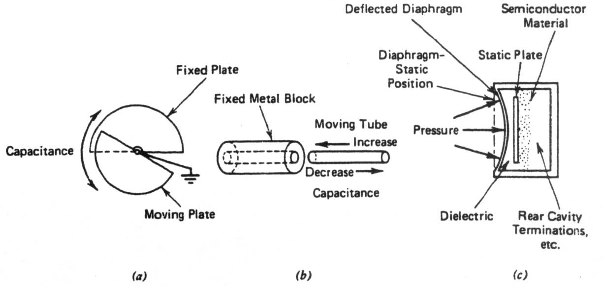
Capacitive transducers(cont’d):-
Figure shows a transducer that varies the spacing between surfaces, that is, the thin diaphragm. The dielectric is either air or vacuum. Such devices are often used as capacitance microphones.
Fig (5) Capacitance transducers

Slide 23
Capacitive transducers(cont’d):-
Capacitance transducers can be used in several ways. One method is to use the varying capacitance to frequency-modulate an RF oscillator. This method is the one employed with capacitance microphones like Fig. (5).
Another method is to use the capacitance transducer in an ac bridge circuit. The capacitance transducer has excellent frequency response and can measure of static and dynamic phenomena.
Its disadvantage are sensitiv­ity to temperature variations and the possibility of erratic or distorted signals owing to long lead length.

Slide 24
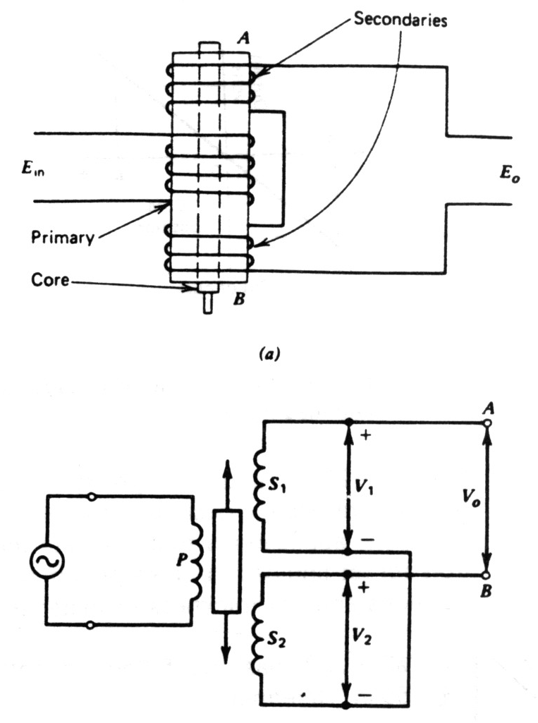
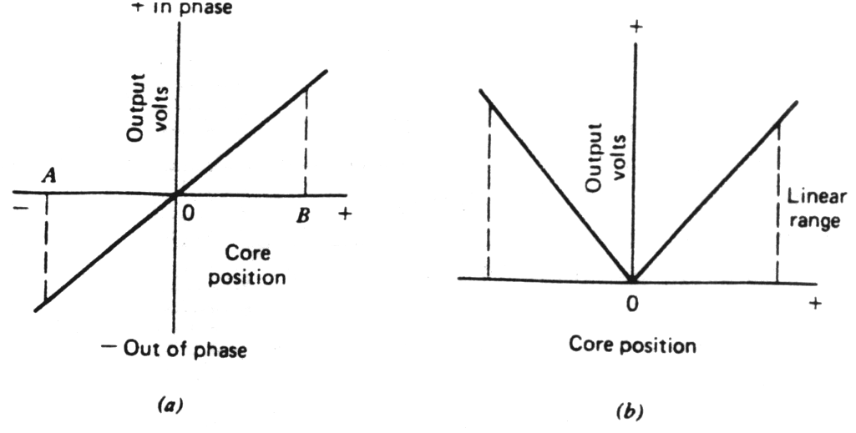
4.Variable Inductive Transducer:

Slide 25
4.Variable Inductive Transducer:
Passive inductive transducers require an external source of power. The action of the transducer is principally one of modulating the excitation signal.
The differential transformer is a passive inductive transformer. It is also known as the linear variable differential transformer (LVDT) and is shown constructively in Fig. (6-a)
It consists basically of a primary winding and two secondary windings, wound over a hollow tube and positioned so that the primary is between two secondary's.

Slide 26
Variable Inductive Transducer(cont’d):-
An iron core slides within the tube and therefore affects the magnetic coupling between the primary and the two secondaries. When the core is in the center, the voltage induced in the two secondaries is equal.
When the core is moved in one direction from center, the voltage induced in one winding is increased and that in the other is decreased. Movement in the opposite direction reverses this effect.

Slide 27
Variable Inductive Transducer(cont’d):-
In the schematic diagram shown in Fig. (6-b), the windings are con­nected "series opposing." That is, the polarities of V1 and V/2 oppose each other as we trace through the circuit from terminal A to terminal B. Conse­quently, when the core is in the center so that V, = V₂, there is no voltage output, V,=0.

Slide 28
Variable Inductive Transducer(cont’d):-
When the core is away from center toward S₁, V₁ is greater than V₂ and the output voltage V_{o} will have the polarity of V₁.
Fig (6) The linear variable differential transformer
(a) Construction. (b) Schematic diagram.

Slide 29
Variable Inductive Transducer(cont’d):-
When the core is away from center toward S₂. V₂ is greater than V₁, and the output will have the polarity of V₂. That is, the output ac voltage inverts as the core passes the center position. The farther the core moves from center.
the greater the difference in value between V₁ and V₂, and consequently the greater the value of V₀. Thus, the amplitude of V₀ is a function of the distance the core has moved and the polarity or phase indicates which direction it has moved
Fig. (6).

Slide 30
4.Variable Inductive Transducer:
LVDT provides continuous resolution and show low hysteresis
Repeatability is excellent under all condition
No sliding contact, so less friction and less noise
Sensitive to vibrations and temperature
Receiving instrument must be selected to operate on ac signals or demodulator network must be used if a dc output is required

Slide 31
2-Strain Gauge Transducers
The strain gauge is an example of a passive transducer the; uses electrical resistance variation in wires to sense the strain produced by a force on the wires. It is a very versatile detector and transducer for measuring weight pressure mechanical force, or displacement.

Slide 32
Strain Gauge Transducers(cont’d)
The construction of a bonded strain gauge Fig (3) shows a fine-wire element looped back and forth on a mounting plate, which is usually cemented to the member undergoing stress. A tensile stress tens to elongate the wire and thereby increase its length and decrease its cross-sectional area. The combined effect is an increase in resistance as seen from
Eq. (1)
(1)
Where
= the specific resistance of the conductor material in ohm
L = the length of the conductor in meters
A = the area of the conductor in square meters

Slide 33
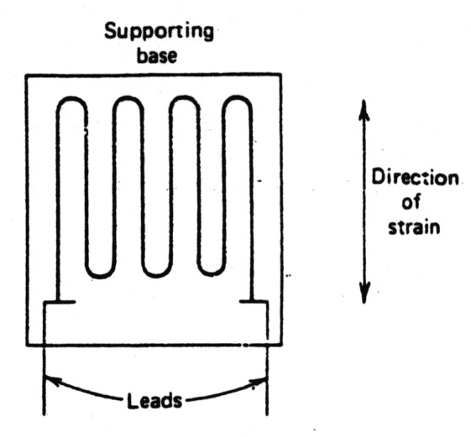
Strain Gauge Transducers(cont’d)
Fig (3) Resistive strain gauges; wire construction

Slide 34
Strain Gauge Transducers(cont’d)
As a consequence of strain two physical qualities are of particular interest: (1) the change in gauge resistance and (2) the change in length. The relationship between these two variables expressed as a ratio is called the gauge factor.
K. Expressed mathematically as
(2)
Where
K = the gauge factor
R = the initial resistance in ohms (without strain)
= the change in initial resistance in ohms
L = the initial length in meters (without strain)
= the change in initial length in meters

Slide 35
Strain Gauge Transducers(cont’d)
Note that the term IL in the denominator is the same as the unit strain G. Therefore. Eq. (2) can be written as
(3)
Robert Hooke pointed out in the seventeenth century that for many common materials there is a constant, ratio between stress and strain.

Slide 36
Strain Gauge Transducers(cont’d)
Stress is defined as the internal force per unit area. The stress equation is
(4)
Where
S = the stress in kilograms per Square meter
F = the force in kilograms
A = the area in square meters

Slide 37
Strain Gauge Transducers(cont’d)
The constant of proportionality between stress and strain for a linear stress-strain curve is known as the modulus of elasticity of the material. E or Young's modulus. Hooke's law is written as
(5)
Where
E =Young's modulus in kilograms per square meter
S = the stress in kilograms per square meter
G = the strain (no units)

Slide 38
Strain Gauge Transducers(cont’d)
For strain gauge applications, a' high degree of sensitivity is very desirable. A high gauge factor means a relatively large resistance change for a given strain. Such a change is more easily measured than a small resistance change. Relatively small changes in strain can be sensed.

Slide 39
Strain Gauge Transducers(cont’d)
Semiconductor strain gauges are often used in high-output transducers as load cells. These gauges are extremely sensitive, with gauge factors from 50 to 200. They are however, affected by temperature fluctuations and often behave in a nonlinear manner. The strain gauge is generally used as one arm of a bridge. The simple arrangement shown in Fig. (2-a) can be employed when temperature varia­tions are not sufficient to affect accuracy significantly, or in applications for which great accuracy is not required.

Slide 40
Strain Gauge Transducers(cont’d)
The strain gauge is generally used as one arm of a bridge. The simple arrangement shown in Fig. (4-a) can be employed when temperature varia­tions are not sufficient to affect accuracy significantly, or in applications for which great accuracy is not required.

Slide 41
Strain Gauge Transducers(cont’d)
However, since gauge resistance is affected by temperature, any change of temperature will cause a change in the bridge balance conditions. This effect can cause an error in the strain measurement. Thus, when temperature variation is significant, or when un­usual accuracy is required an arrangement such as that illustrated in Fig. (4) may be used.

Slide 42
Strain Gauge Transducers(cont’d)
Here two gauges of the same type are mounted on the item being tested close enough together that both are subjected to the same temperature. Consequently, the temperature will cause the same change of resistance in the two, and the bridge balance will not be affected by the temperature. However one of the two gauges is mounted so that its sensitive direction is at right Angles to the direction of the strain.

Slide 43
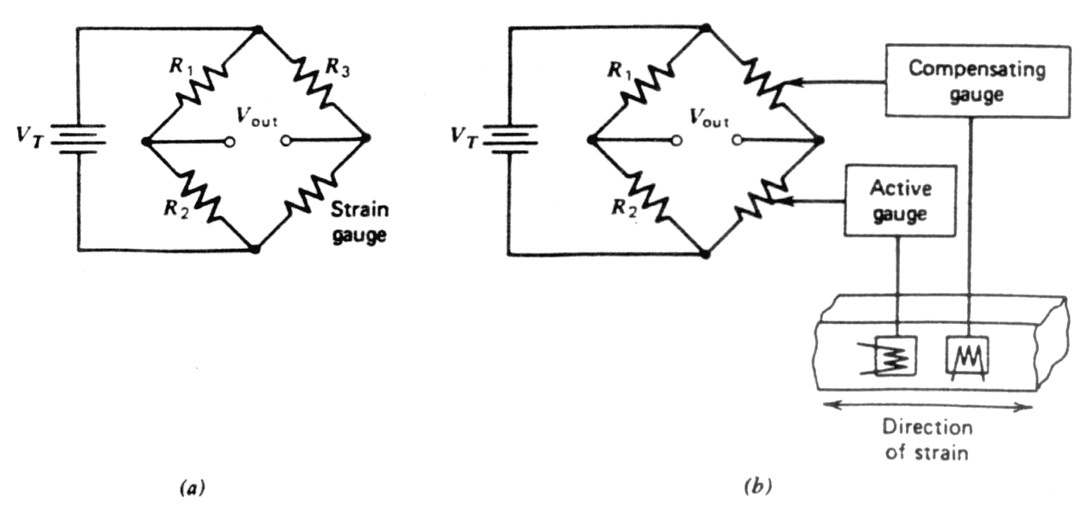
Strain Gauge Transducers(cont’d)
The resistance of this dummy gauge is not affected by the deformation of the material. Therefore, it acts like a passive resistance (such as R₃ of Fig. 4-b) with regard to the strain measurement. Since only one gauge responds to the strain, the strain causes bridge unbalance just as in the case of the single gauge.
Fig (4) Basic gauge bridge circuits.

Slide 44
6.Temperature Transducer:-
Temperature transducers can be divided into four main categories.
Resistance temperature detectors (RTD).
Thermocouples.
Thermistors.
Ultrasonic thermometer.

Slide 45
Temperature Transducer(cont’d):- 1. Resistance temperature detectors (RTD):-
Detectors of resistance temperatures commonly employ platinum, nickel, or resistance wire elements, whose resistance variation with temperature has a high intrinsic accuracy.
They are available in many configurations and sizes and as shielded or open units for both immersion and surface applications.

Slide 46
Temperature Transducer(cont’d):- 1. Resistance temperature detectors (RTD):-
The relationship between temperature and resistance of conductors can be calculated from the equation.
Where
R = The resistance of the conductor at temperature t (°C)
R_{o} = The resistance at the reference temperature, usually 20°C
= The temperature coefficient of resistance
T = The difference between the operating and the reference
Temperature

Slide 47
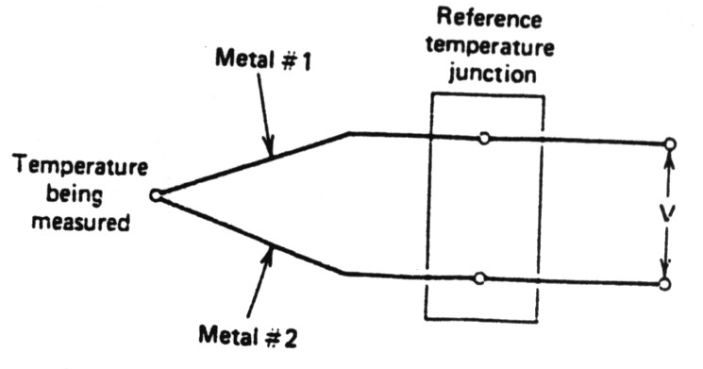
Temperature Transducer(cont’d):- 2. Thermocouples:-
One the most commonly used methods of measuring temperature in science and industry depends on the thermocouple effect.
When a pair of wires made of different metals are joined together at one end, temperature difference between this end and the other end of the wires produces a voltage between the wires Fig. (9).

Slide 48
Temperature Transducer(cont’d):- 2. Thermocouples:-
The magnitude of this voltage depends on the materials used for the wires and the amount of temperature difference between the joined ends and the other ends.
The junction of the two wires of the thermocouple is called the sensing junction. In normal use this junction is placed in or on the material being tested, and the other ends of the wire are connected to the voltage-measuring equipment.

Slide 49
Temperature Transducer (cont’d):- 2. Thermocouples:-
Since the temperature difference between this sensing junction and the other ends is the critical factor, the other ends are either kept at a constant reverence temperature or, when the cost of the equipment is very low, simply maintained at room temperature.
When the other ends are kept at room temperature, the temperature is monitored and the thermocouple output voltage readings are corrected for any changes in room temperature.

Slide 50
Temperature Transducer (cont’d):- 2. Thermocouples:-
Because the temperature at this end of the thermocouple wires is a reference tempera­ture, the junction here with the equipment terminals or with other connecting wires is known as the reference junction.
It is also quite often referred to as the co/d junction. Because the thermocouple is frequently used for measuring high temperatures, the reference junction it such cases is indeed the colder of the two junctions.

Slide 51
Temperature Transducer (cont’d):- 2. Thermocouples:-
Since any junction of dissimilar metals will produce some thermocouple voltage, the wires and any metal terminals between the sensing junction and the rest of the equipment must be carefully controlled.
Usually this means that the wires between the sensing junction and the reference junction are of specific materials provided by the thermocouple supplier, and the wires from the reference junction to the measuring equipment are copper.

Slide 52
Temperature Transducer (cont’d):- 2. Thermocouples:-
Thermocouples are made from a number of difference metals or metal alloys covering a wide range of temperatures from as low as -270°C(-418°F) to as high as 2700`C (about 5000°F).
Fig (9) Schematic representation of a thermocouple assembly.

Slide 53
Temperature Transducer (cont’d):- 2. Thermocouples:-
The magnitude of the thermal emf depends on the wire materials used on the temperature difference between the junctions. Figure (11) shows thermal emfs for some common thermocouple materials. The values shown are based on a reference temperature of 32°F. The effective emf of thermocouple is given as
Where
c and k =constants of the thermocouple materials
T₁ =the temperature of the "hot" junction
T₂ =the temperature of the "cold" or "reference" junction

Slide 54
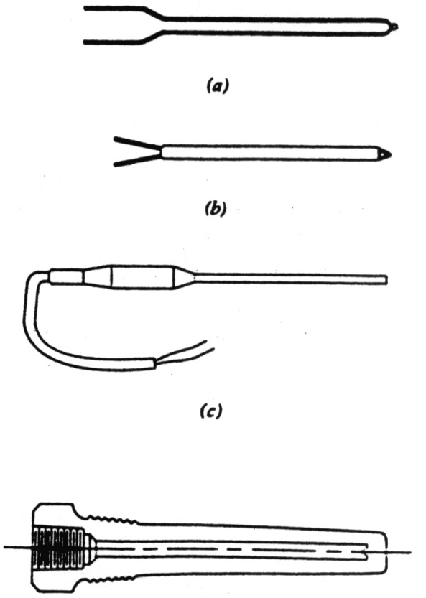
Temperature Transducer (cont’d):- 2. Thermocouples:-
Fig (10) Thermocouples and thermocouple assemblies. (a) Uninsu­lated thermocouple. (b) Insulated thermocouple. (c) Probe assembly. (d) Thermocouple well.

Slide 55
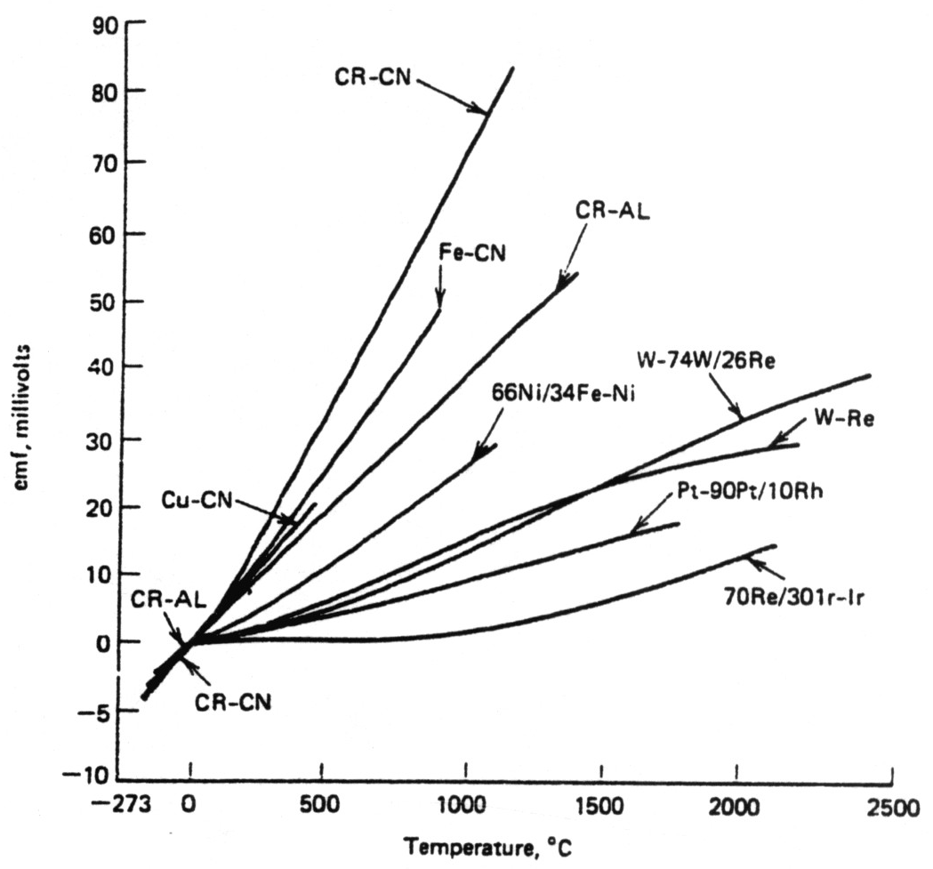
Temperature Transducer (cont’d):- 2. Thermocouples:-
Fig (11) Calibration curves for several thermocouple combi­nations.

Slide 56
Temperature Transducer (cont’d):- 3. Thermistors.:-
The electrical resistance of most materials changes with the temperature. By choosing materials that are very sensitive to temperature, we can make devices that are useful in temperature control circuits as well as in tempera­ture measurement.
A thermistor is a semiconductor made by sintering mixtures of metallic oxide, such as oxides of manganese, nickel, cobalt, copper, and uranium. Thermistors have a negative temperature coefficient. That is, their resis­tance decreases as their temperature rises.

Slide 57
Temperature Transducer (cont’d):- 3. Thermistors.:-
Thermistors can be connected in series-parallel arrangements for applica­tions requiring greater power-handling capability.
High-resistance units find application in measurements that employ wires or cables with small quantities of lead. Thermistors are chemically stable and can be used in nuclear environments.
Their wide range of characteristics also permits them to be used in limiting and regulation circuits, as time delays, for the integration of power pulses, and as-memory units.

Slide 58
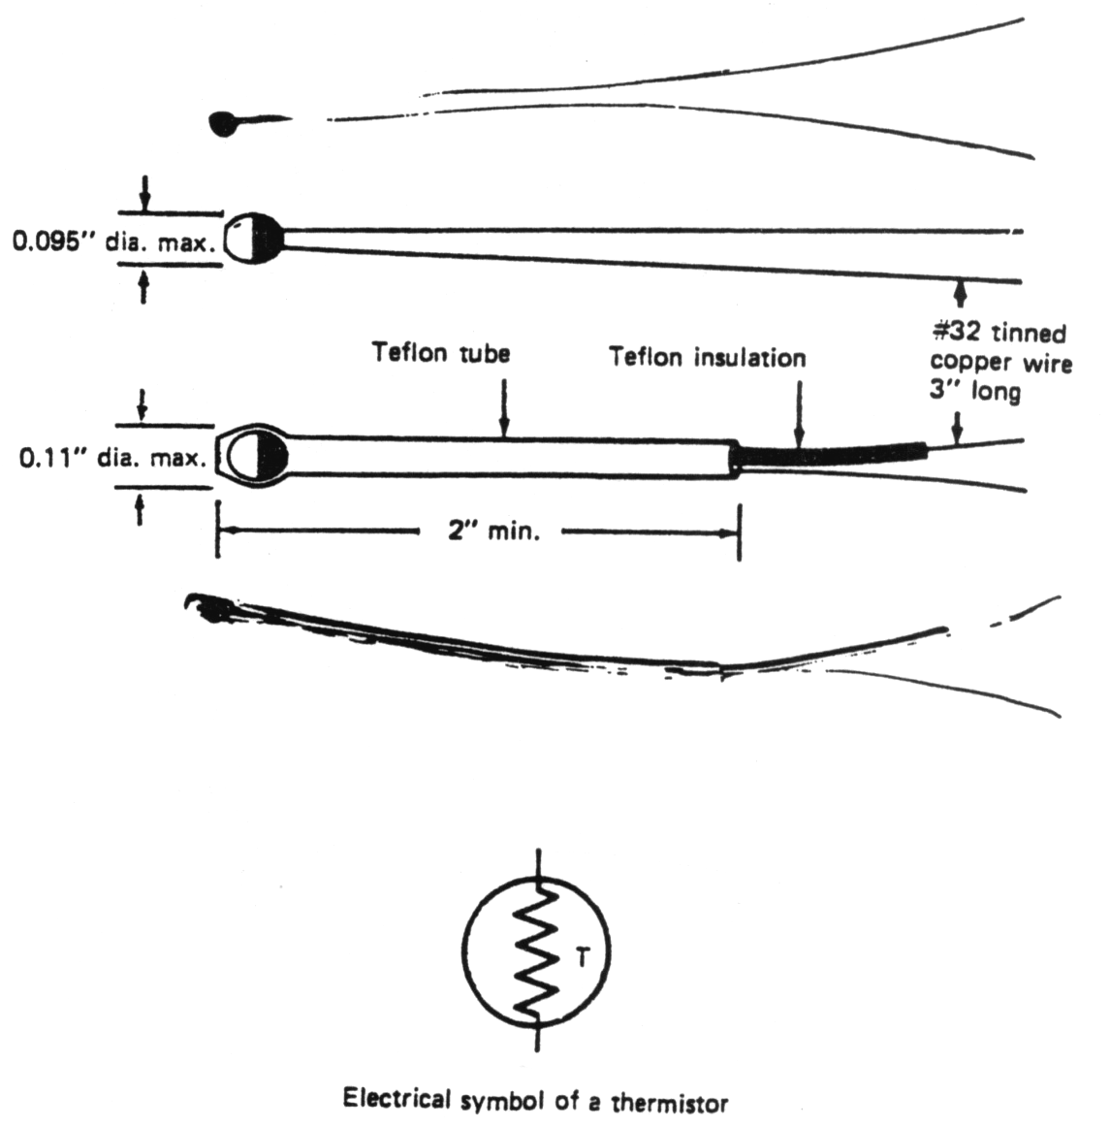
Temperature Transducer (cont’d):- 3. Thermistors.:-
Typical thermistor configurations are shown in Fig. (13) and the electri­cal symbol of the device is depicted in the same figure.
Fig (13) thermistor configuration and the electrical symbol for a thermistor. (Courtesy Yellow Springs Instrument Company, Yellow Springs, Ohio.)

Slide 59
Temperature Transducer (cont’d):- 3. Thermistors.:-
A thermistor in one leg of a Whetstone bridge circuit will provide pre temperature information. In most applications accuracy is limited only by readout device.
Thermistors are nonlinear over a temperature range, although units today are available with a better than 0.2% linearity over a temperature range of to 100°C. The typical sensitivity of a thermistor is approximately 3 mV/°C at 200°C.

Slide 60
Light Emitting Diode: LED

Slide 61
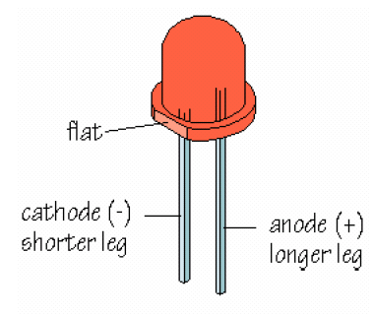
What is an LED?
Light-emitting diode
Semiconductor
Has polarity

Slide 62
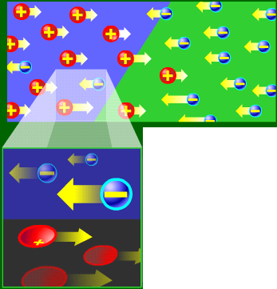
LED: How It Works
When current flows across a diode
Negative electrons move one way and positive holes move the other way

Slide 63
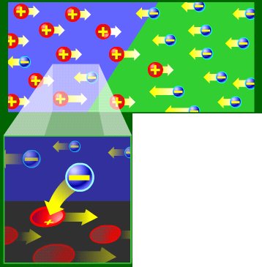
LED: How It Works
The wholes exist at a lower energy level than the free electrons
Therefore when a free electrons falls it losses energy

Slide 64
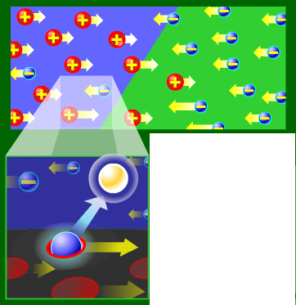
LED: How It Works
This energy is emitted in a form of a photon, which causes light
The color of the light is determined by the fall of the electron and hence energy level of the photon

Slide 65
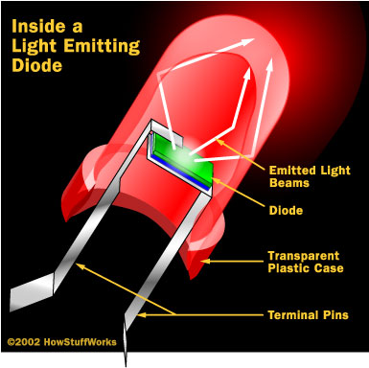
Inside a Light Emitting Diode
Transparent Plastic Case
Terminal Pins
Diode

Slide 66
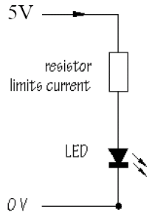
How to Connect a LED:
Requires 1.5~2.5V and 10 mA
To prevent overloading, use resistor 470 Ω

Slide 67
LASER :
Light
Amplification by
Stimulated
Emission of
Radiation
But what does this mean?

Slide 68
Absorption of light
When light passes through materials it is usually absorbed.
In certain circumstances light may be amplified.
This was called “negative absorption”
It is the basis of laser action
Notes:
2

Slide 69
Light and an atom
Electron transitions between energy levels
Light amplification by stimulated emission of radiation
Lower state full
Upper state empty
Light absorbed
Lower state empty
Upper state full
MORE light emitted
Einstein 1917
Notes:
2

Slide 70
Can light amplify light?
Amplification:
Need more electrons at high energy than at low energy.
No one thought this could be done
stimulated emission just a theoretical curiosity for about 30 years!
Notes:
2
“negative absorption” first observed transiently in nuclear magnetic resonance experiments by Felix Bloch 1946.
Similar experiments by Purcell and Pound led them to introduce the term “negative temperature” in 1951.
Population inversion gains some respectability!

Slide 71

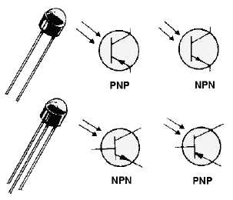
Phototransistors
Behave like regular transistors, but:
Use light-sensitive collector-base junction to control collector- emitter current (I_{CE})
Base often unconnected, otherwise biased to adjust sensitivity to light
Small collector-emitter leakage current when no light is incident, called dark current

Slide 72
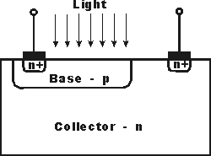
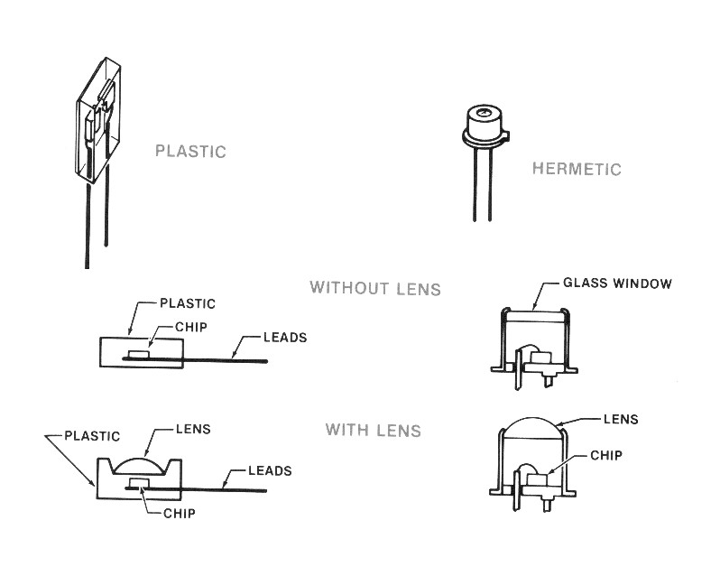
Phototransistor Structure and Packaging
http://www.radio-electronics.com/info/data/semicond/phototransistor/photo_transistor.php

Slide 73
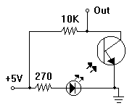
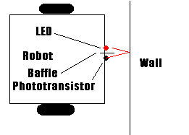
Phototransistor Application: Obstacle Detection
Adjust baffle length to vary detection range
Use IR LED and Photodiode to avoid visible light interference
Use multiple sensors in a row to detect narrow obstacles

Slide 74
Phototransistors: Additional Notes
Must be properly biased (as with regular transistors)
Used in linear and saturation/cut-off regions
Sensitive to temperature changes
Must be protected against moisture
Hermetic packaging more expensive, but more tolerant of severe environments than plastic packaging

Slide 75
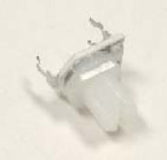
The Potentiometer
Also known as a “pot”
It’s a dial that can be turned
Nothing more than a variable resistor

Slide 76
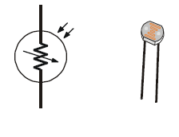
The Photoresistor
Like the potentiometer, the photoresistor is a variable resistor
Unlike the potentiometer, it is not [directly] human controlled

Slide 77
Schematic
The schematic shows it as a resistor with light coming into it (note the arrows are opposite those of an LED)

Slide 78
Usage
We are going to use them just as we did the potentiometer
An RC circuit
Charge the capacitor
Let the capacitor drain through the photoresistor
Value of the photoresistor (and capacitor) will determine the time constant of the circuit

Slide 79
Photo diode A photodiode is a type of photodetector capable of converting light into either current or voltage, depending upon the mode of operation.

Slide 80
Operation
A photodiode is a PN junction or PIN structure. When a photon of sufficient energy strikes the diode, it excites an electron, thereby creating a mobile electron and a positively charged electron hole.
If the absorption occurs in the junction's depletion region, or one diffusion length away from it, these carriers are swept from the junction by the built-in field of the depletion region.
Thus holes move toward the anode, and electrons toward the cathode, and a photocurrent is produced.

Slide 81
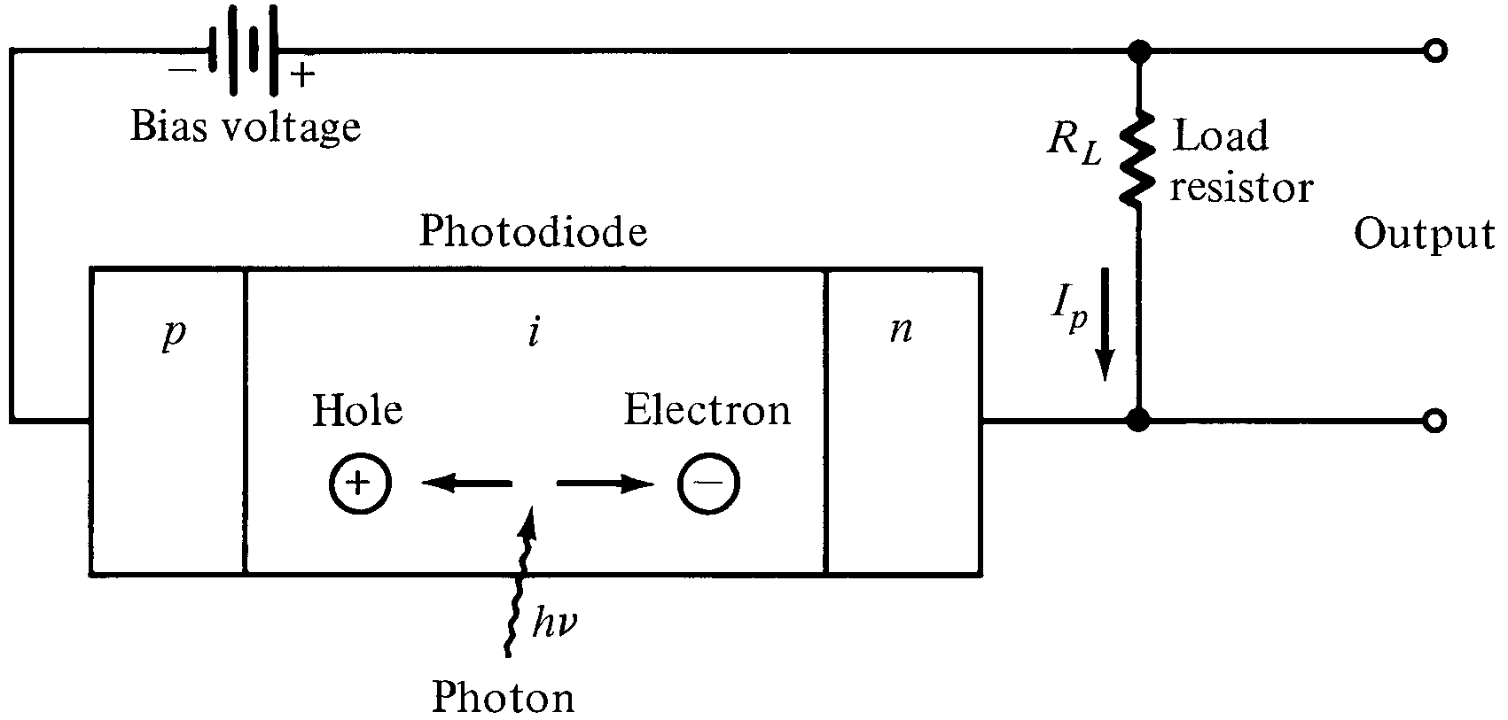
Photodiode
w
The high electric field present in the depletion region causes photo-generated carriers to
Separate and be collected across the reverse –biased junction. This give rise to a current
Flow in an external circuit, known as photocurrent.

Slide 82
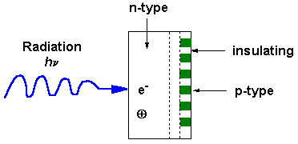
How does it work?
http://elchem.kaist.ac.kr/vt/chem-ed/optics/detector/pda.htm
Basically, a whole bunch of capacitors that detect how much charge was released.

Slide 83
Advantages
Faster
More diodes
High S/N Ratio
Faster scan = less time for noise
More rugged/durable
No moving scanning part

Slide 84
Applications
P-N photodiodes are used in similar applications to other photodetectors, such as photoconductors, charge-coupled devices, and photomultiplier tubes.
Photodiodes are used in consumer electronics devices such as compact disc players, smoke detectors, and the receivers for remote controls in VCRs and televisions.

Slide 85
8. Photo Electric Transducers:
A photoelectric transducer can be categorized as photoemissive, photoconductive, or photovoltaic. In photoemissive devices, radiation falling on a cathode causes electrons to be emitted from the cathode surface.
In photoconductive devices, the resistance of a material is changed when it is illuminated. Photovoltaic cells generate an output voltage proportional to radiation intensity.
The incident radiation may be infrared, ultraviolet, gamma rays, or X rays as well as visible light.

Slide 86
Photo Electric Transducers (cont’d):- 8.2. Photoconductive Cells or Photocells
Another photoelectric effect that has proved very useful is the photoconduc­tive effect, which is used in photoconductive cells or photocells.
In this type of device the electrical resistance of the material varies with the amount of light striking it.A typical form of construction is shown in Fig. (18-a).

Slide 87
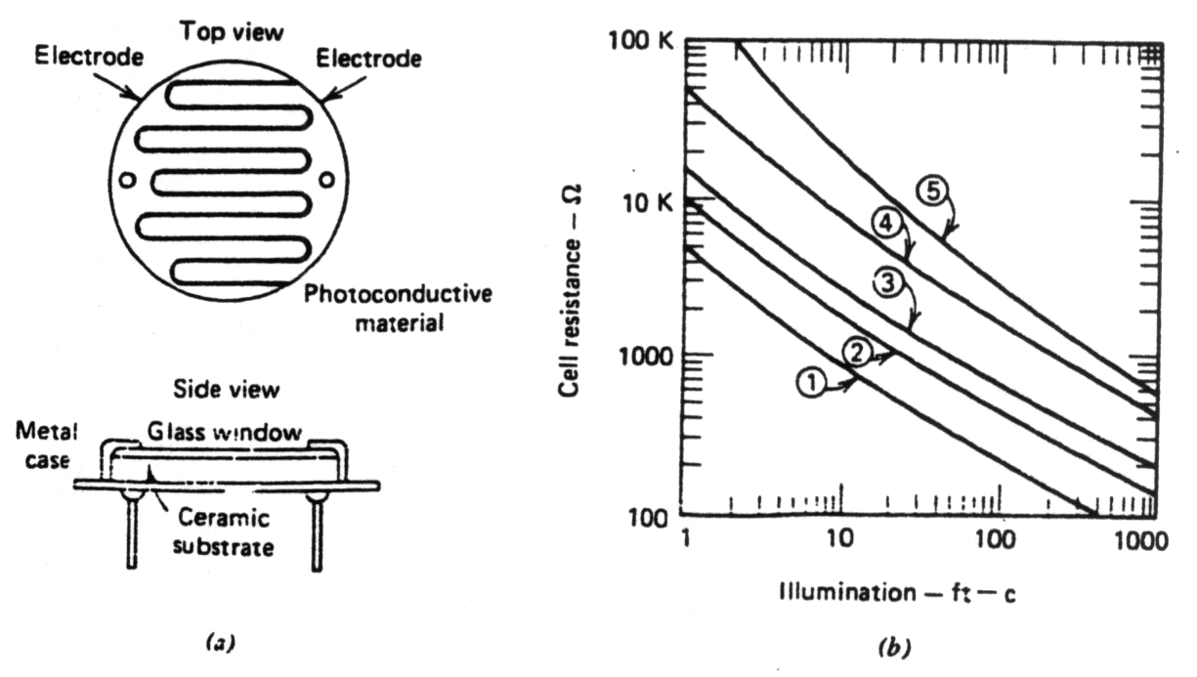
Photo Electric Transducers (cont’d):- 8.2. Photoconductive Cells or Photocells
The photoconductive material, typically cadmium sulfide, cadmium selenide, or cadmium sulfoselenide, is deposited in a zigzag pattern, to obtain a desired resistance value and power rating.
Fig (18) Photoconductive cell. (a) Construction. (b) Typical curves of resistance versus illumination.

Slide 88
Photo Electric Transducers (cont’d):- 8.2. Photoconductive Cells or Photocells
The material separates two metal-coated areas acting as electrodes, all on an insulating base such as ceramic. The assembly enclosed in a metal case with a glass window over the photoconductive material. Photocells of this type are made in a range of sizes, having diameters of one-eighth inch to over one inch..

Slide 89
Photo Electric Transducers (cont’d):- 8.2. Photoconductive Cells or Photocells
The small sizes are suitable where spa is critical, for example, in equipment for reading punched cards and similar applications. However, the very small units have very low power dissipation ratings.
A typical control circuit utilizing a photoconductive cell is illustrated in Fig. The potentiometer is used to make adjustments to compensate for manufacturing tolerances in photocell sensitivity and relay-operating sensitivity.

Slide 90
Photo Electric Transducers (cont’d):- 8.2. Photoconductive Cells or Photocells
When the photocell has the appropriate light shining on it, its resistance will be low and the current through the relay will consequently be high enough to operate the relay. When the light is interrupted, the resistance will rise, causing the relay current to decrease enough to deenergize the relay.

Slide 91
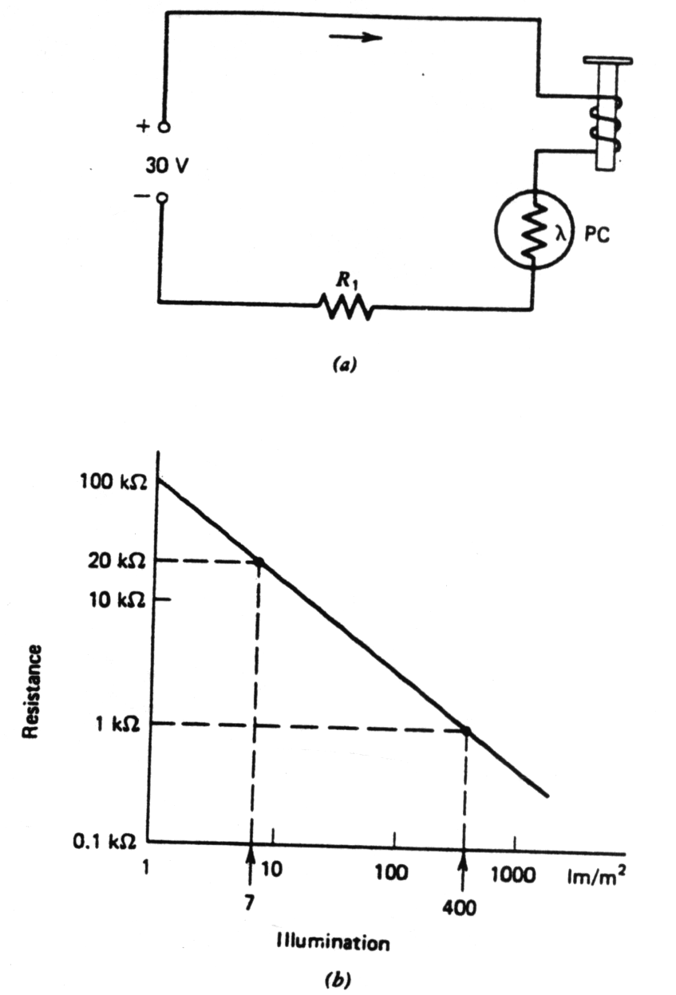
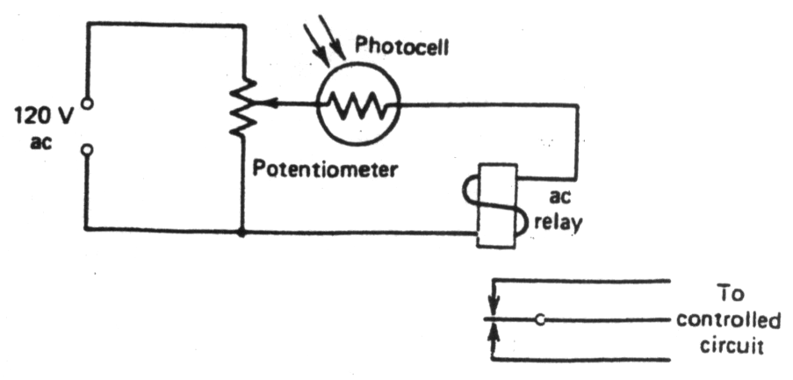
Photo Electric Transducers (cont’d):- 8.2. Photoconductive Cells or Photocells
Fig (19) Photocell and relay control circuit.
Fig (20) (a) Relay control by a photocon­ductive (PC) cell and (b) PC cell illumination characteristics.

Slide 92
Photo Electric Transducers (cont’d):- 8.3. The Photovoltaic Cell
The photovoltaic cell, or "solar cell," as it is sometimes called, will produce an electrical current when connected to a load. Both silicon (Si) and selenium (Se) types are known.
Photovoltaic cells may be used in a number of applications. Multiple-unit silicon photovoltaic devices may be used for sensing light as a means of reading punched cards in the data processing industry.
Gold-doped germanium cells with controlled spectral responses act as photovoltaic devices in the infrared region of the spectrum and may be used as infrared detectors.

Slide 93
Solar cells
Photovoltaic Cell

